Slide 1
Original Questions/hypothesis
Is the response to N increasing over time?
Yes, yield at zero N is expected decrease overtime due to depletion of SOM, while genetic improvement will increase the yield potential at the high N rates and will follow statewide yield increases over time ~ 2bu/yr
If yes is, which rate if either is causing the increase and why?
Is variability around each rate equal per rotation?
Probably not, soil N supplied by mineralization is influenced heavily by soil temp and water availability. Suggesting that N supply and therefore N stress at zero N will have a greater impact on grain yield than at a high N rate where N stress is mitigated.

Slide 2
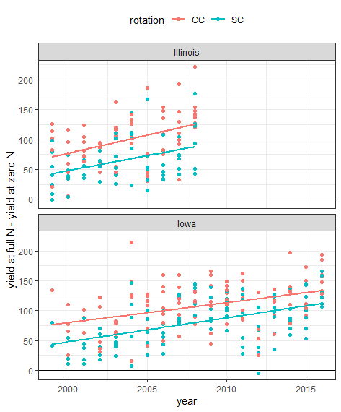
Is the yield response to N increasing over time?
State | Rotation | Mean change | Standard Dev. change | Slope Bu/A/yr
IL | CC | 99 | 44 | 6.1
IL | SC | 65 | 37 | 5.0
IA | CC | 108 | 40 | 3.4
IA | SC | 82 | 39 | 4.0

Slide 3
Statistical analysis of the slopes
Slope ~ site + rotation + rate + site*rate + site*rotation + rate*rotation + E
 | df | Sum sq | Mean sq | F value | signif
Site | 13 | 217.5 | 16.73 | 14.8 | ***
Rotation | 1 | 0.32 | 0.32 | 0.29
Rate | 1 | 323.29 | 323.29 | 286.6 | ***
site*rate | 13 | 178.4 | 1.72 | 12.6 | ***
Site*rot | 13 | 30.45 | 2.34 | 2.07
Rate*rot | 1 | 1.49 | 1.49 | 1.3
error | 13 | 14.66 | 1.13

Slide 4
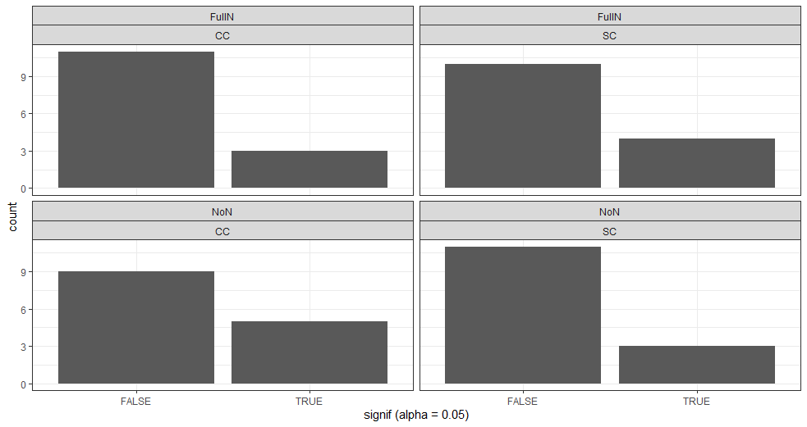
Is the slope of any of these regressions significant?

Slide 5
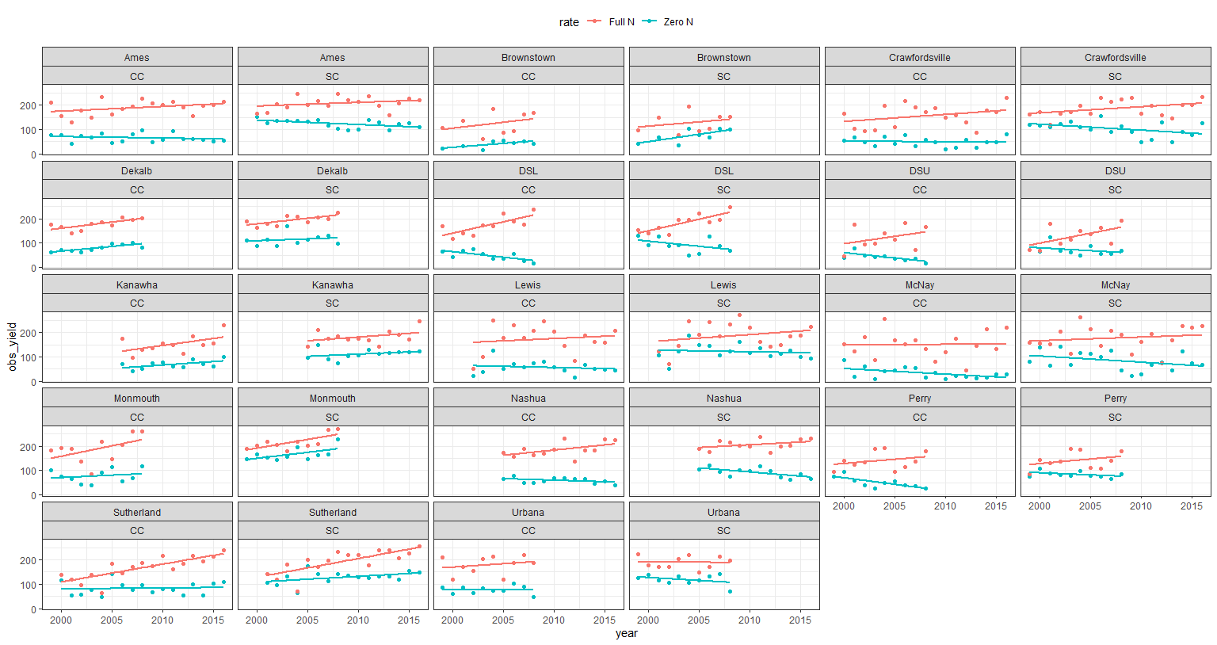
which rate if either is causing the increase and why?

Slide 6
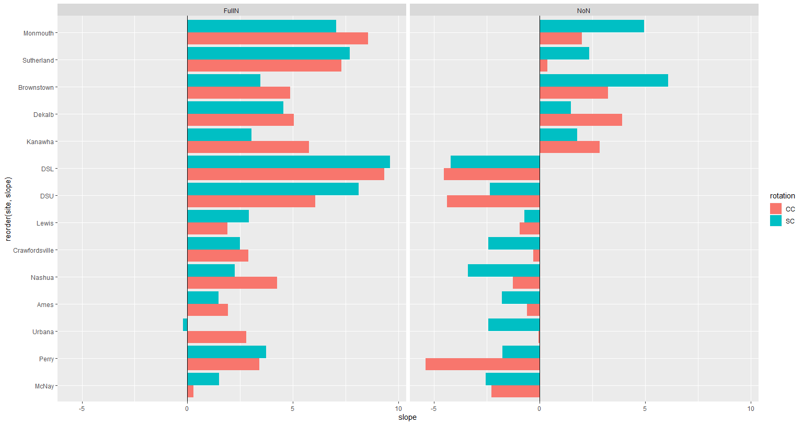
Summary of the slopes

Slide 7
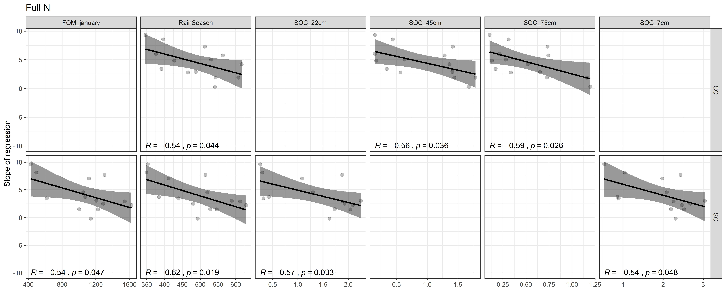
Correlation of slope vs soil weather and mang. vars

Slide 8
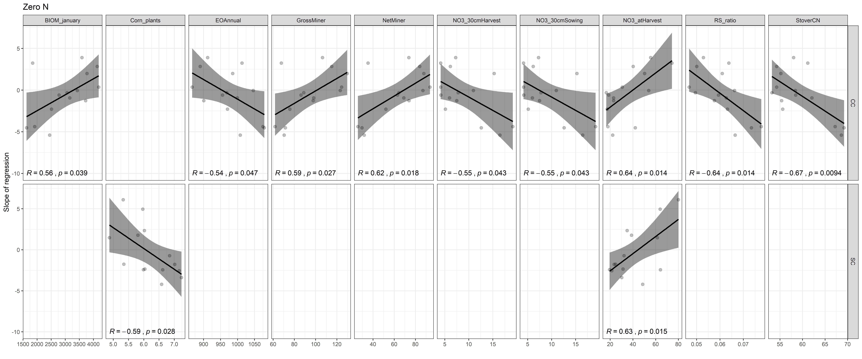
Correlation of slope vs soil weather and mang. vars

Slide 9
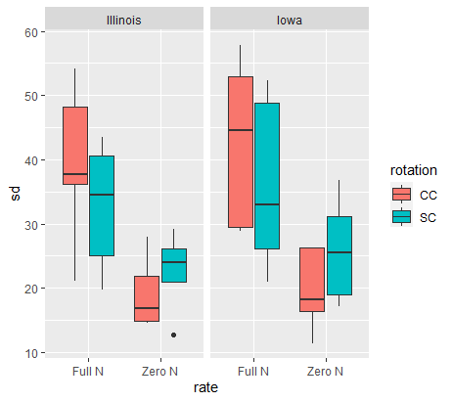
Is variability per rate equal?

Slide 10
Summary
Zero N has more stable yields over time than full N rates
All slopes at the Full N are increasing except for Urbana SC, however the slope of that regression is insignificant (p value = 0.94)
Slopes at Zero N are inconsistent, but tend to be highly correlated with soil N characteristics

Slide 11
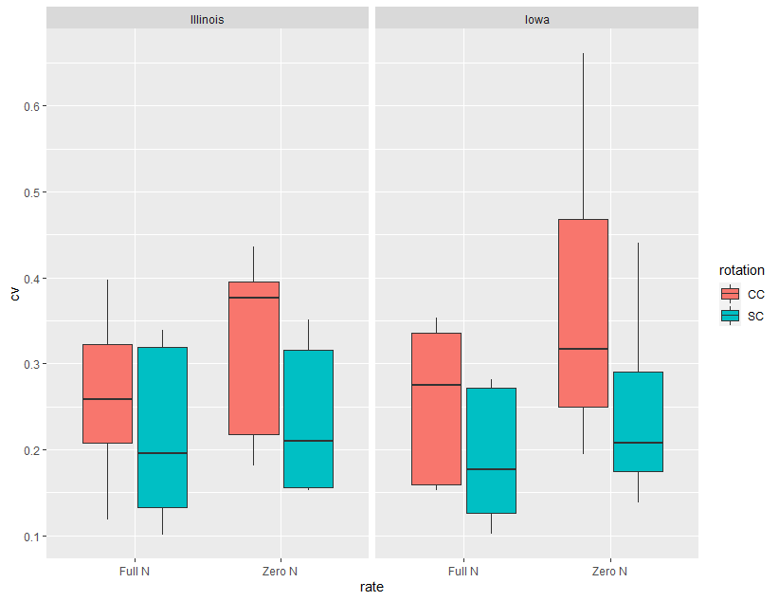
Bonus slide- you were right about the cv

